Slide 1
Restart the computer system

Slide 2

About me
Sapunaru Andrei Iliuta
https://github.com/Andrei64-ux
Polytechnic University of Bucharest
Faculty of Automatic Control and Computer Science
Department : IT Gaesti
Manager : Grigore Virgil
Tutor : Marcu Catalin

Slide 3
Table of content
Necessity to restart / shutdown a computer system
Application and utility
Graphically user interface
The reason why I chose this project
Conclusion
Questions

Slide 4
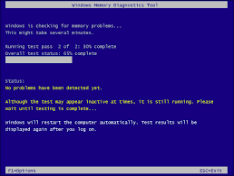
Slowness or RAM Problems
Application Errors or Memory Leaks
One of the most common reasons to restart your computer is to clear the RAM cache. Without going into too much detail, RAM provides temporary storage for applications and programs as they run. Unfortunately, as they run, some of this data begins to pile up even though it’s not being used.
Why does restarting your computer help? Because application developers are human, too, and sometimes the software they create can have some unintended side effects. This can lead to slowness, like our first example, or even prevent the software from operating correctly.
Internet Connectivity
Sometimes the Wi-Fi just doesn’t work, try restarting! This can refresh the network settings for your computer without completely resetting them. It can be easy to get bogged down in all of your network settings, so try this before taking any additional, complex steps.

Slide 5
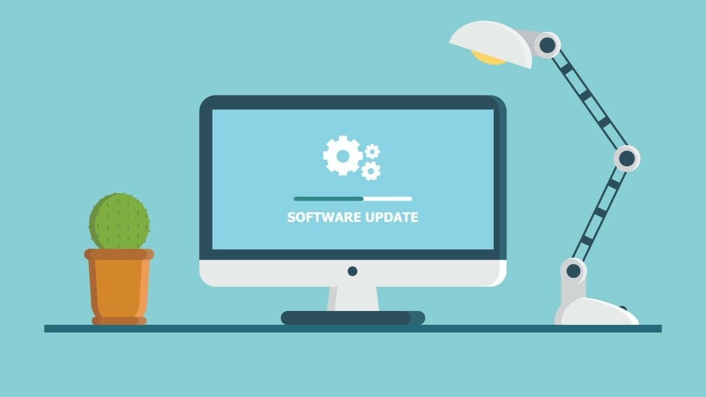

Updates
Performance Issues
Your computer lives on patches and updates. Most of the time these updates download automatically but require a reboot to install. Recently downloaded updates are one of the most common reasons to restart your computer.
100% CPU usage? Is RAM full? Any idea what this means? Restart. Our computers are complex, and for the untrained individual, it could take hours to reach a solution. You may not know exactly what caused the issue, but there’s a good chance a restart will clear it up.

Slide 6
Fixes Emergent Issues
Here are some of the times rebooting can help you fix an emergent issue:
=> If your computer feels hot
=> If the fans inside your device are making excessive noise
=> After a software or firmware update
=> After you’ve installed new hardware
=> You’re experiencing application crashes
=> Things are freezing or taking longer then usual to respond
=> A file or application won’t open

Slide 7
Application and utility
I tried to make an application that solve somehow the problems presented above . This application is as a timer , has same mechanism . User choose the time firstly and then choose the option for system . The shutdown command with the IP address will be used . The IP addresses are read from a database , check if this are valid and check if I can ping an IP address. In another database , I write the data from last restart and the data from next restart .

Slide 8
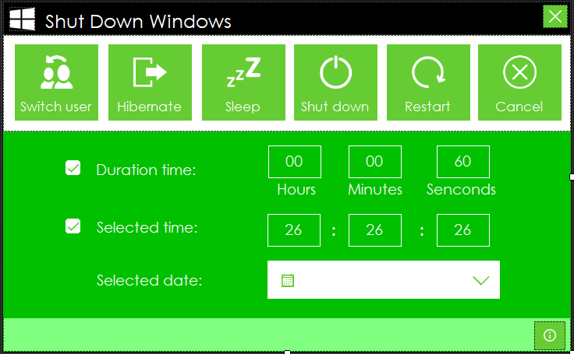


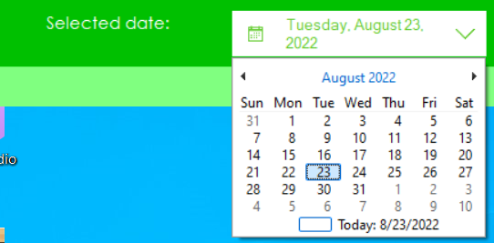
User interface
When I start the app , an interface appear . This contain a lot of options that action to a computer system . Of course , are presented possibilities that you can choose to set the time for when you want to shutdown system .
Duration time
Selected time
Main window
Selected date

Slide 9
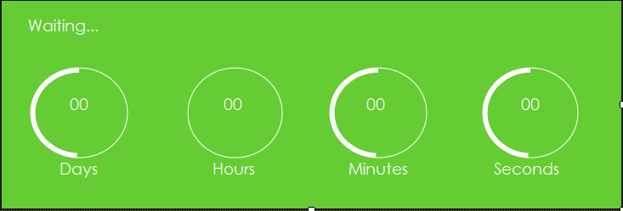
After you choose the option and the time , on desktop appear a dialog box where are represented the timer such a lot of circles with a progress bar that shrinks over time.

Slide 10
Why did I choose this project?
I chose this project at the suggestion of the department. It seemed to me an ingenious idea, useful and applicable in a timely manner in the factory. It was also a challenge because I had to learn a new language, c#, but at a basic level. The project is made exclusively by me, with small details taken from the internet and I completed the application in approximately 3 weeks. It was a real challenge, because compared to the faculty, new work situations appeared at the office.

Slide 11
Conclusion
My application works on a hardcoded test , but in company I didn’t test because this fact means to stop the production line.
I tried to implement an optimal solution.
I use the libraries disposed of Visual Studio.
I respected the parameters and requirement.
It is used as a preventive method.

Slide 12
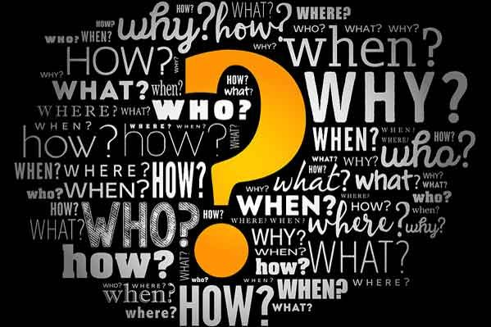

Slide 13


